Slide 1
Secondary Career Pathway Funding – What’s Next
This webinar will be recorded and posted to the ODE Website.
ODE has a website with information about Secondary Career Pathway Funding – please visit the website for continued updates
Please mute your microphones. Please put your question in the chat box and we will answer questions at the end.
Thank you for your attendance!

Slide 2
Secondary Career Pathway Funding – What’s Next?
January 14, 2016
PILOT
http://www.ode.state.or.us/search/page/?id=5415

Slide 3
Agenda for this webinar
Review of legislative intent and allocations
How it works
Rules
Roles and responsibilities
Accessing the funds
Assurances
Budget and narrative
Submission of documents
Contact information

Slide 4
Secondary Career Pathway Funding
How it works

Slide 5
Purpose
CTE Revitalization
Up to $500K
Revitalize, refurbish, start up
Questioned sustainability
Career Pathways Funding
First attempt at sustained funding
Incentivize intensive CTE programs of study that lead to high wage and high demand occupations

Slide 6
Funding
HB 3072-
OAR 581-017-0287 to -0297
$8.75 million Secondary Career Pathway Funding for the biennium
$3 million – January 2016 +
Remaining funds – October 2016

Slide 7
How Allocations Are Generated
Student in
CTE Program of Study
Historically Underserved
Approved Industry Credential

Slide 8
Methodology
Student earns 3 unduplicated credits in CTE POS
As reported in the CTE Data Collection June 2015
In pathway leading to high wage, high demand occupation
Match to ADM collection
Enrolled and in attendance May 2015
Underserved
Students of color, students experiencing poverty, English language learners, students with disabilities
Industry credentials
March 2016

Slide 9
What this might look like…
XYZ High School | Program of Study | Student with 3+ Credits | Underserved | Allocation
 | State Recognized Fire Science | -- | -- | $0.00
 | Ag Science | No data submission | -- | $0.00
 | Construction | 0 |  | $0.00
 | Manufacturing | 3 | 1 | $1200 $2000
 | Marketing | 45 | 23 | $20,400
 | Health Science | 127 | 117 | $73,200 $45,000

Slide 10
Communication
Webinar
Web page
News announcement
Letter to superintendent & CTE Regional Coordinator

Slide 11
Use of Funds
Professional Development
Release Time for Curriculum Development
Program and Student Evaluation
Additional Instructor
Building Infrastructure
Materials and Equipment

Slide 12
Fund Distribution
School District
School
Program

Slide 13
Working Together

Slide 14
In the Rules
Funds will be spent only on the CTE Program of Study generating the funds.
Decisions about the expenditure of funds will be made in collaboration with the teacher of the CTE Program, the CTE Regional Coordinator, and school administration.
Funds awarded will not be used to supplant funds budgeted by the district for the CTE Program generating the funds during the 2015-2016 and the 2016-2017 school years.

Slide 15
How it works
CTE Program of Study
Teacher
Administrator
CTE Regional Coordinator

Slide 16
Roles and Responsibilities
Role of CTE program teacher
Determine use of funds with school district administration and CTE regional coordinator
Problem solve with administration and CTE regional coordinators about use of funds
Report any questions or concerns to ODE grant manager

Slide 17
Roles and Responsibilities
Role of school district administration
Determine use of funds with teacher and CTE regional coordinator
Submit budget and assurances – non-supplanting; reporting
Problem solve with teachers and CTE regional coordinator regarding use of funds
Report and questions or concerns to ODE grant manager

Slide 18
Roles and Responsibilities
Role of CTE Regional Coordinator
Review preliminary data
Collaborate with CTE content specialists on high wage and high demand
Determine use of funds with teacher and school/district administration
Problem solve with districts, schools and teachers regarding use of funds
Report questions/concerns to ODE grant manager
Grant award to RC for technical assistance and support

Slide 19
Roles and Responsibilities
Role of grant manager at ODE – Donna Brant
Collect data and calculate allocations
Work with specialists to determine high wage and high demand programs
Communicate
Provide technical assistance
Distribute and collect assurances and budget
Set up fund distribution through EGMS
Collect reports

Slide 20
How to access the funds

Slide 21
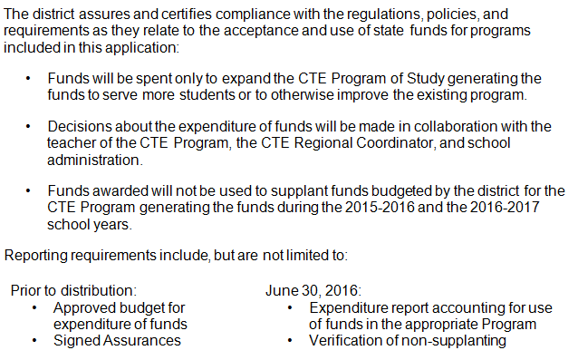
Assurances

Slide 22
Budget Documents
Narrative
Describe how the investment of Secondary Career Pathways Funds was determined. Who was involved in the decision making and what was the extent of their involvement?
Identify focus of investment

Slide 23
Use of Funds
Professional Development
Release Time for Curriculum Development
Program and Student Evaluation
Additional Instructor
Building Infrastructure
Materials and Equipment

Slide 24
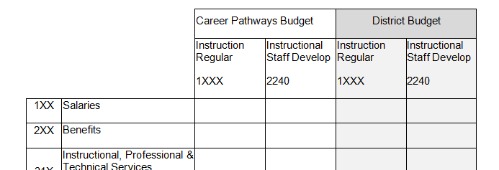
Budget Documents

Slide 25
Once Submitted to ODE
Email budget narrative and worksheet to: Career.pathways@ode.state.or.us
Review and record documentation
Clarification as needed on budget
Approved via EGMS

Slide 26
Contact
Donna Brant
Donna.brant@state.or.us
503-947-5622
Barb O’Neill
Barbara.oneill@state.or.us

